Slide 1

Transformer
ARCHITECTURE
Batuhan Yildirim, Academic Slave & TA mostly
26 March, 2025
Kadir Has
University

Slide 2
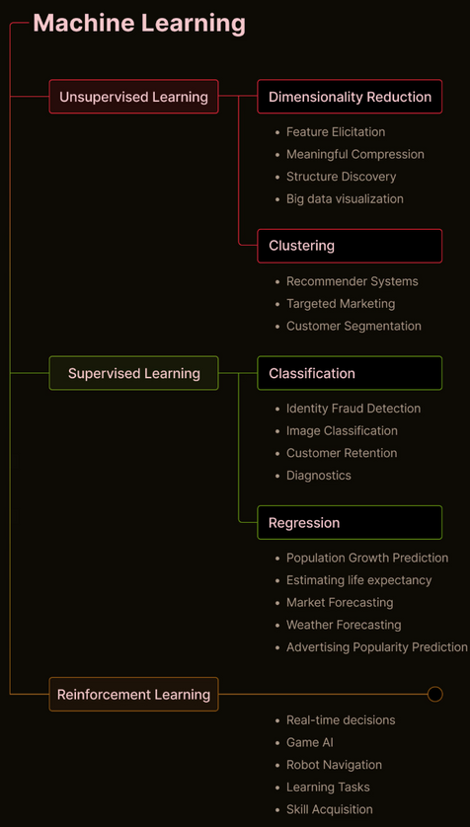

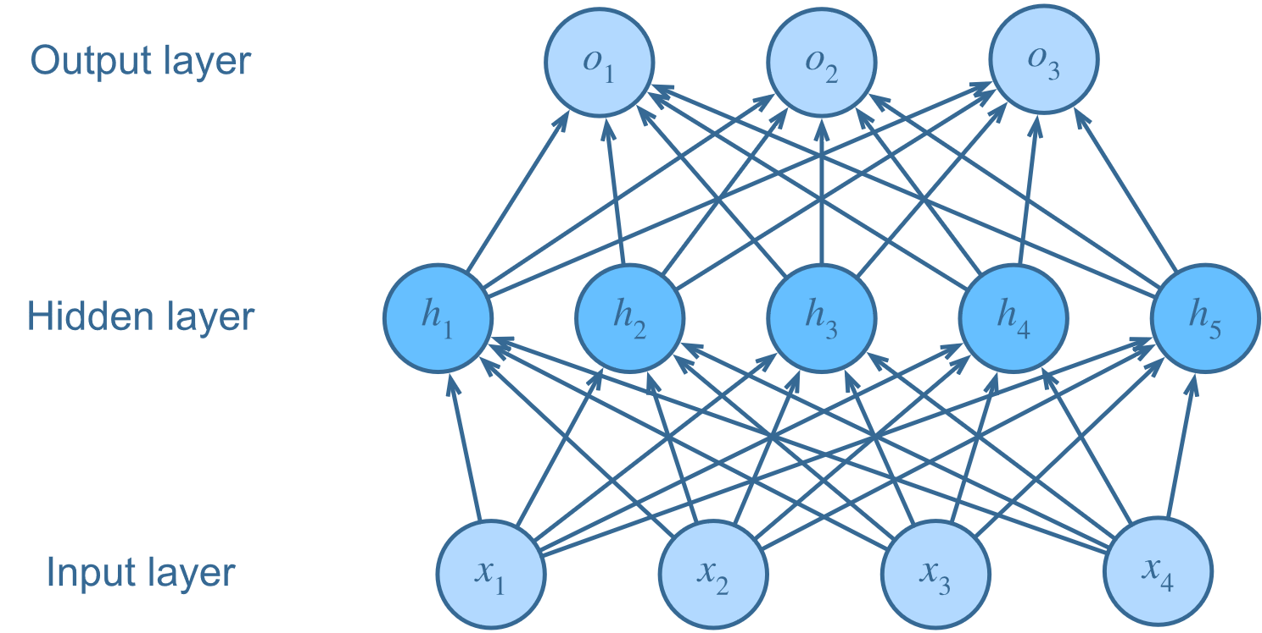

PRELIMINARIES CHECKLIST
Learning Types
Neural Networks &
Model Architecture
Python + PyTorch
Kadir Has
University

Slide 3
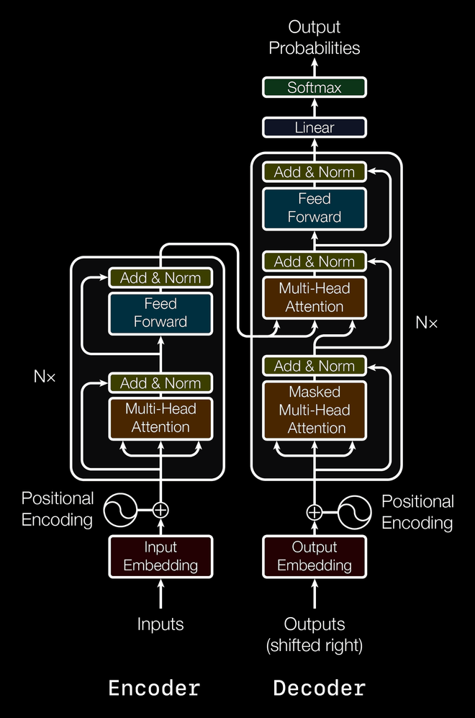
ARCHITECTURE
Encoder
Embeddings
Self-Attention Residual
MHA
LayerNorm
FeedForward Residual
FeedForwardNetwork (FFN)
LayerNorm
Decoder
Embeddings
Masked Attention Residual
MHA
LayerNorm
Cross Attention Residual
MHA
LayerNorm
FeedForward Residual
FeedForwardNetwork (FFN)
LayerNorm
Linear
Vocab_Projection for next token gen
# of class for prediction
You know what it is
Kadir Has
University
Ref: https://caisplusplus.usc.edu/curriculum/neural-network-flavors/transformers

Slide 4
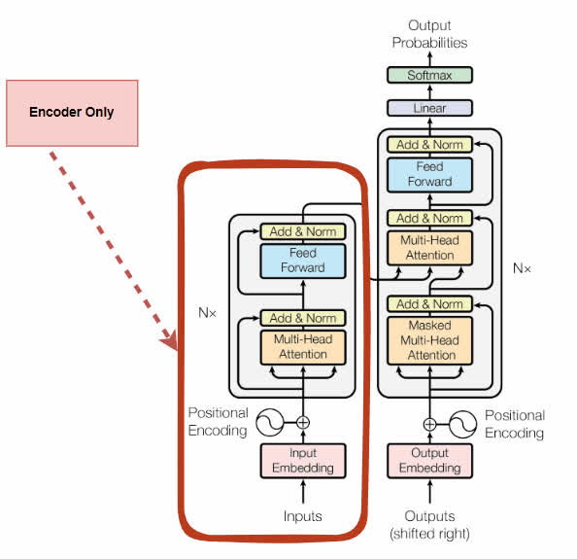
ENCODER (BERT)
The title is the tip
Kadir Has
University

Slide 5
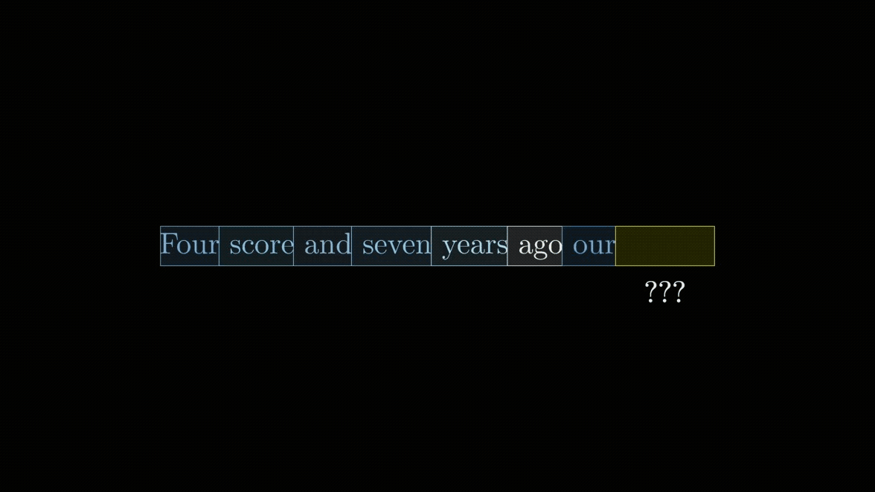
EMBEDDINGS
Models don’t see strings and need numbers as inputs.
Every word has representation on vector space
Word Embedding
Kadir Has
University
Ref: https://github.com/3b1b/videos/tree/master/_2024/transformers

Slide 6
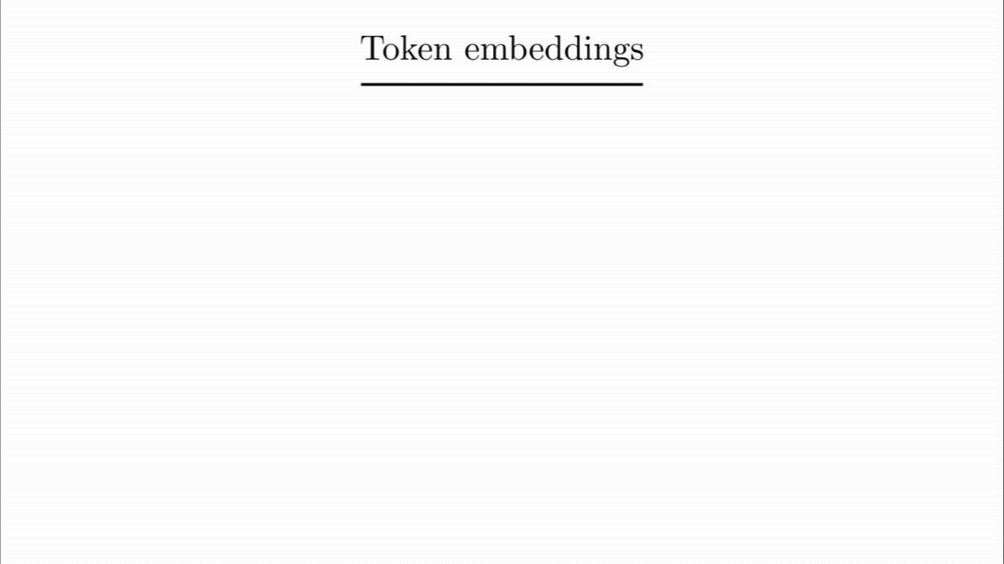
EMBEDINGS- (CONT.)
Token Embedding
Kadir Has
University
Ref: https://prvnsmpth.github.io/animated-transformer/

Slide 7
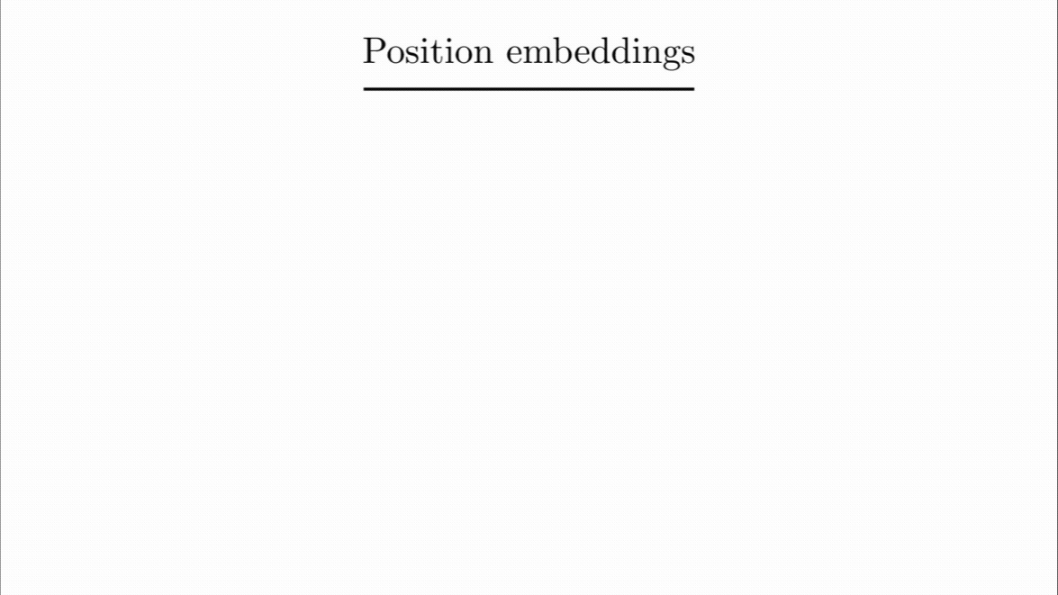
EMBEDINGS- (CONT.)
Positional Embedding
Kadir Has
University
Ref: https://prvnsmpth.github.io/animated-transformer/

Slide 8
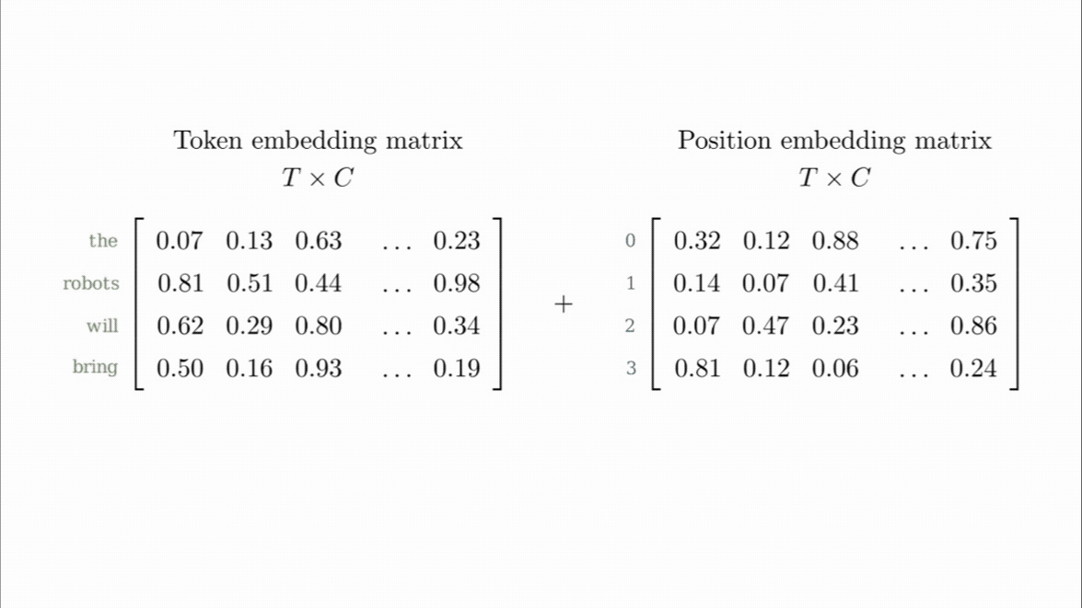
EMBEDINGS- (CONT.)
Positional Embedding Applied
Kadir Has
University
Ref: https://prvnsmpth.github.io/animated-transformer/

Slide 9

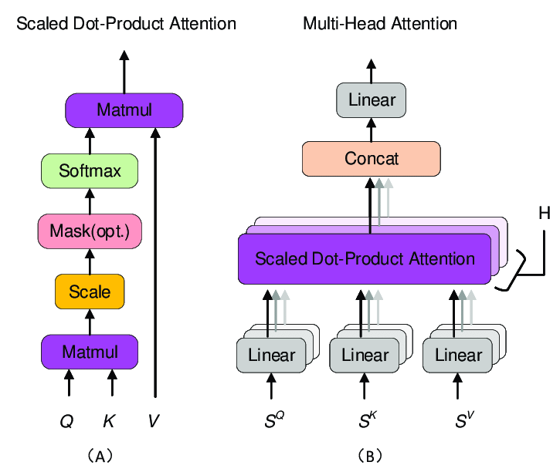
ATTENTION MECHANISM
Still on Encoder
Self-attention
Kadir Has
University

Slide 10
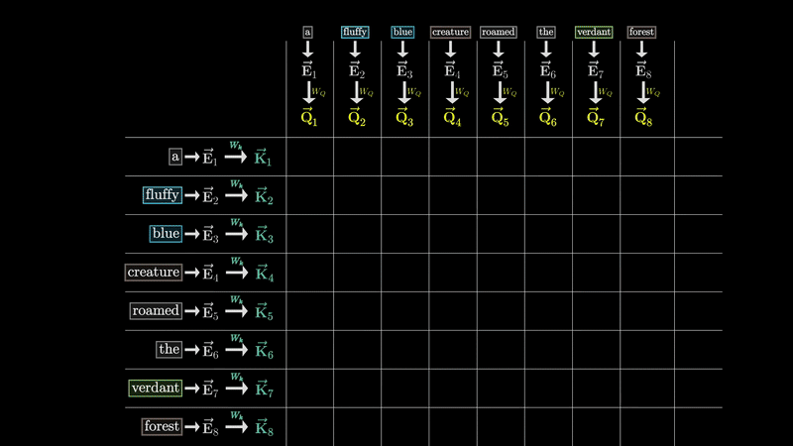
ATTENTION MECHANISM (CONT.)
Query Key Multiplication
Kadir Has
University
Ref: https://github.com/3b1b/videos/tree/master/_2024/transformers

Slide 11
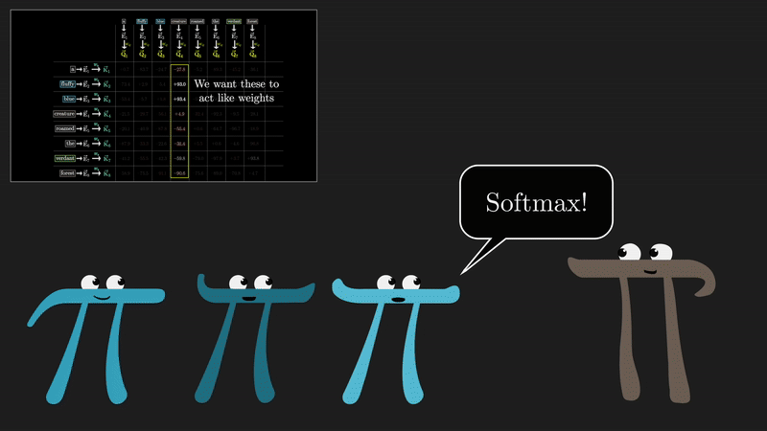
ATTENTION MECHANISM (CONT.)
Softmax
Kadir Has
University
Ref: https://github.com/3b1b/videos/tree/master/_2024/transformers

Slide 12
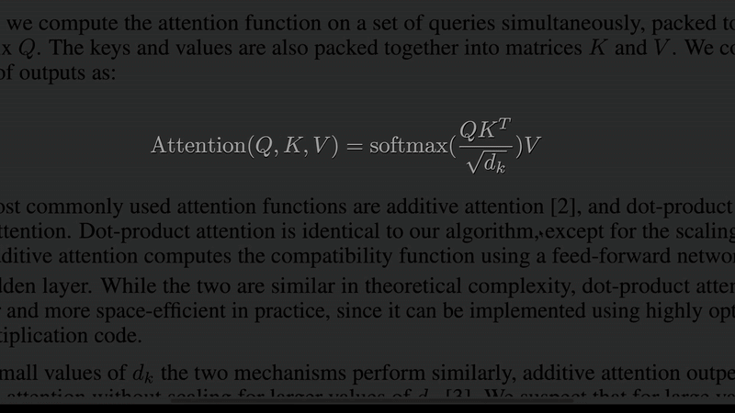
ATTENTION MECHANISM (CONT.)
Query Key - Softmax Applied
Kadir Has
University
Ref: https://github.com/3b1b/videos/tree/master/_2024/transformers

Slide 13
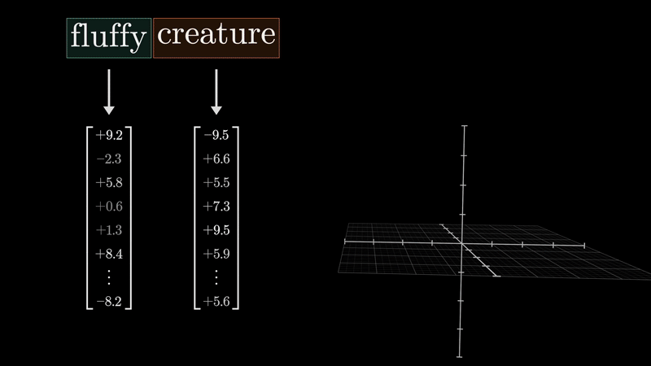
ATTENTION MECHANISM (CONT.)
Value Vector
Kadir Has
University
Ref: https://github.com/3b1b/videos/tree/master/_2024/transformers

Slide 14
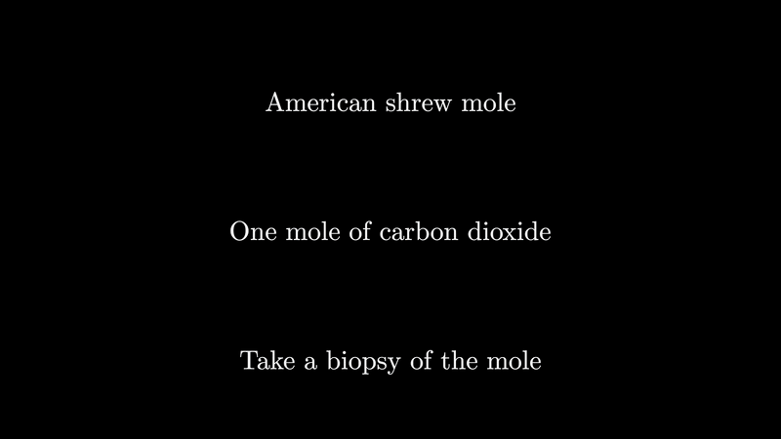
EMBEDDINGS ON ATTENTION
1 = More?
Kadir Has
University
Ref: https://github.com/3b1b/videos/tree/master/_2024/transformers

Slide 15
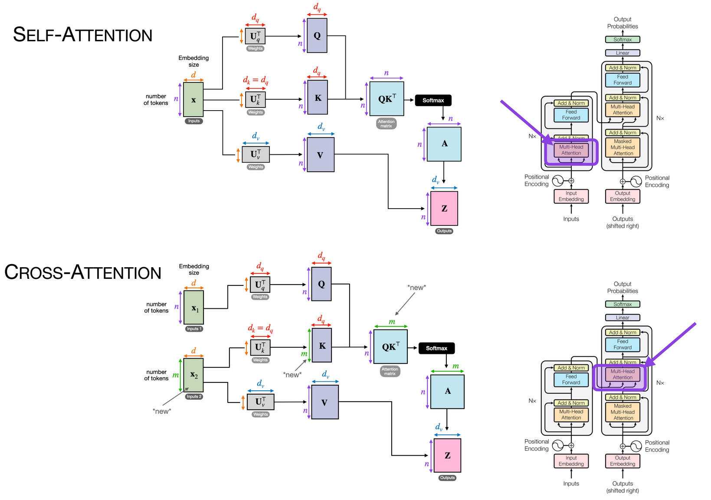
DECODER LAYER (GPT) & ATTENTION TYPES
Encoder
Embeddings
Self-Attention Residual
MHA
LayerNorm
FeedForward Residual
FeedForwardNetwork (FFN)
LayerNorm
Decoder
Embeddings
Masked Attention Residual
MHA
LayerNorm
Cross Attention Residual
MHA
LayerNorm
FeedForward Residual
FeedForwardNetwork (FFN)
LayerNorm
Linear
Vocab_Projection for next token gen
# of class for prediction
Self - Cross Attention
Kadir Has
University

Slide 16
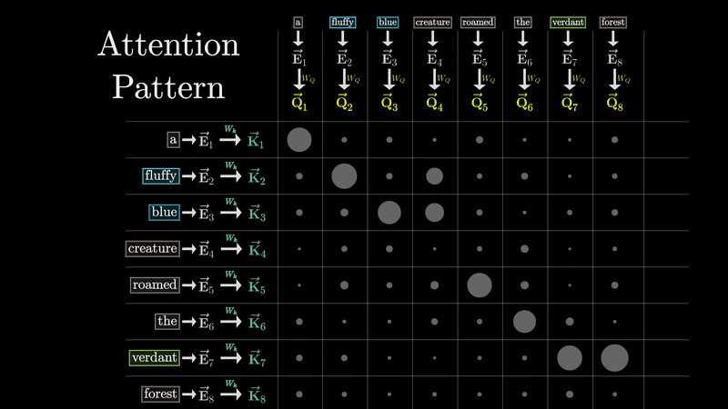
MASKING
GPT aims to generate tokens
Front tokens shouldn’t affect previous ones
Masking
Kadir Has
University
Ref: https://github.com/3b1b/videos/tree/master/_2024/transformers

Slide 17
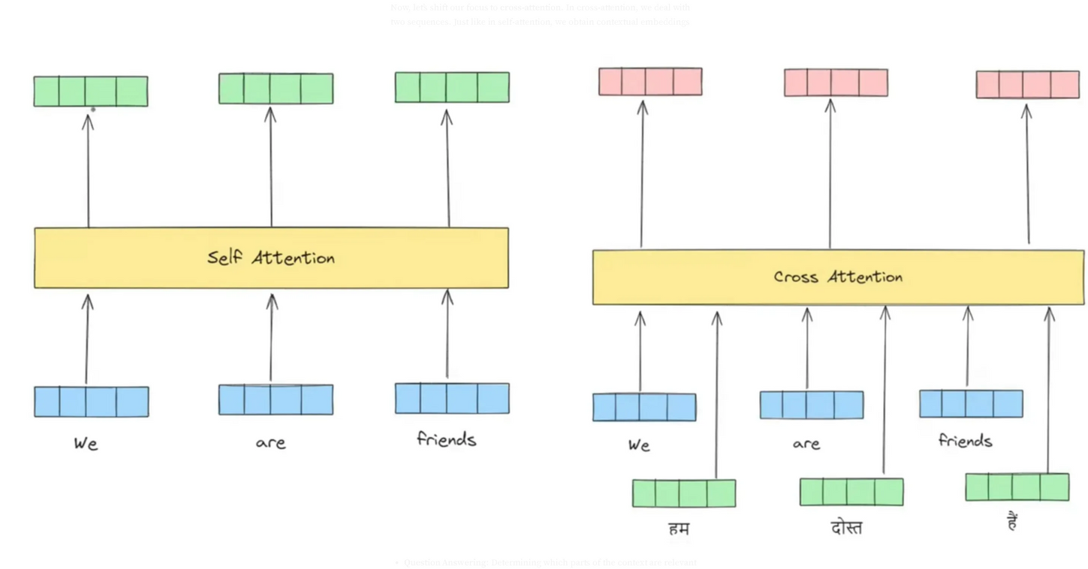
CROSS VARIABLE
Can be;
Input text’s other language version (Translation Example)
A sentence or a group name for supporting class
Self-Cross Attention Example
Kadir Has
University
Ref: https://medium.com/@sachinsoni600517/cross-attention-in-transformer-f37ce7129d78

Slide 18
CONCLUSION
Encoder
Embeddings
Self-Attention Residual
MHA
LayerNorm
FeedForward Residual
FeedForwardNetwork (FFN)
LayerNorm
Decoder
Embeddings
Masked Attention Residual
MHA
LayerNorm
Cross Attention Residual
MHA
LayerNorm
FeedForward Residual
FeedForwardNetwork (FFN)
LayerNorm
Linear
Vocab_Projection for next token gen
# of class for prediction
The Architecture
Kadir Has
University
Ref: https://caisplusplus.usc.edu/curriculum/neural-network-flavors/transformers

Slide 19
Thank you!
ARCHITECTURE
Batuhan Yildirim, Academic Slave & TA mostly
26 March, 2025
Kadir Has
University

